Slide 1







Nurturing Flourishing
High school graduation
READY FOR HIGH SCHOOL
SCHOOL PROGRESS
Ready for school
Healthy birth and early years
Healthy pregnancy
HEALTH, SAFETY, AND OPPORTUNITY ACROSS THE CHILD’S LIFECOURSE
Empathic, high quality health care
Economic vitality of home and community
Mitigated social and environmental adversity
Nurturing, skilled parenting support
Family social connectedness & sense of belonging
Trusted, quality early childhood education
Nurturing home & neighborhood
Social connectedness
Trusted, high quality well-child care
Nurturing, high quality school experience
Environments meeting basic needs
Sense of belonging & future orientation
Nurturing, high quality school experience
Economic vitality of home & community
Sense of purpose & hope for the future
Basic needs for health and well-being
Meaningful work and wealth
Humane housing
Belonging and civic muscle
Lifelong learning
Thriving natural world
Reliable transportation
Accessible urgent services
LEVELS OF
ACTION PROMOTING VITAL CONDITIONS FOR HEALTH AND WELL-BEING
Family and Extended Kin Groups
Neighborhoods and Social Networks
City/State/Federal Policies
Cincinnati Children’s Hospital Medical Center

Slide 2
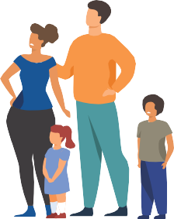


CREATING FLOURISHING
& Downstream Benefits
Providers
Beneficiary Sectors
CARE & TEAM COORDINATION
PUBLIC HEALTH
BEHAVIORAL, ORAL HEALTH
PRIMARY CARE
JOB TRAINING
HOUSING
NUTRITION
OTHER
MEDICAID, MEDICARE, VA
EMPLOYERS
COURTS, CORRECTIONS
HOMELESS PROGRAMS
SCHOOLS
CHILD WELFARE
OTHER
Attributable Lives Layer:
Whole Person Integration of Service Delivery
Community Action Layer:
Other Vital Conditions Programs
Community Collaborative Council
Governance
Scaffolding
Notes:
Many of the beneficiaries roll up to the state govt savings.

Slide 3
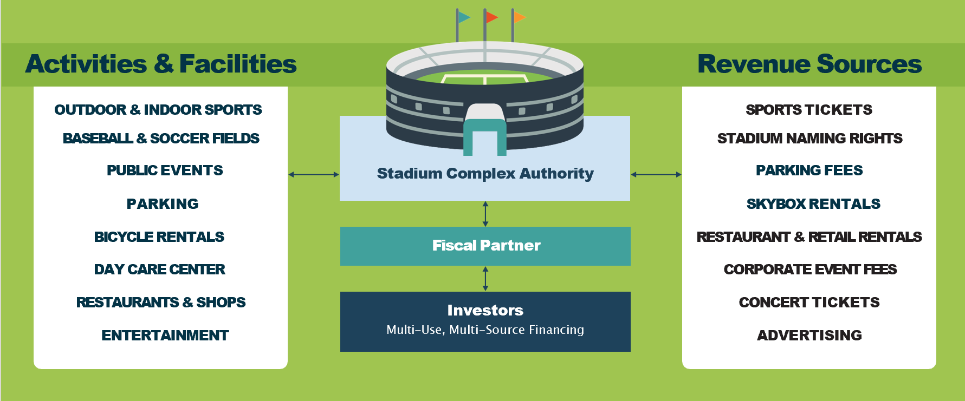
Revisiting the Revenue Model for Sports Stadiums

Slide 4
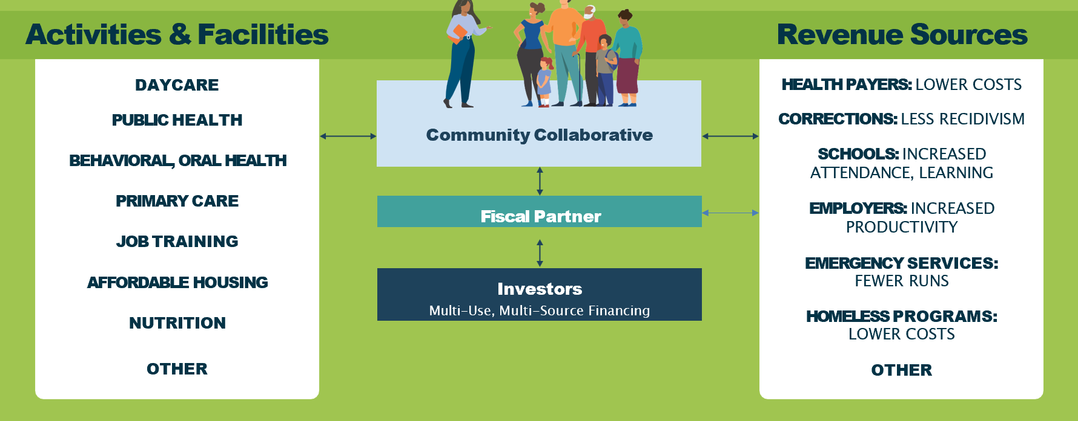
Flourishing Councils Drive the Revenue Model for Flourishing
Flourishing Council
Notes:
Many of the beneficiaries roll up to the state govt savings

Slide 5



The Flourishing Model
FINANCING
(public/private)
FLOURISHING
creates value (revenue/savings)
Community Flourishing Complex
Cincinnati Region
Flourishing Council
Attributable Lives Layer
Whole person/family
integration of services
Community Action Layer
Community-level
Vital Condition interventions
Wealth Building Layer
For individuals, businesses, and communities

Slide 6
The Value Created by Flourishing
Example Outcomes |  | Rate
Education | Increased attendance | $XXX
 | Increased kindergarten readiness | $XXX
 | Decreased special education use | $XXX
Healthcare | Decreased emergency services utilization | $XXX
 | Decreased NICU/hospitalization rate | $XXX
 | Decreased preterm, low weight births | $XXX
Child welfare | Decreased investigations | $XXX
 | Decreased out placement | $XXX
Criminal justice | Decreased incidents | $XXX
 | Decreased redicivism | $XXX
Employers | Decreased health/insurance costs for parents/caregivers | $XXX
 | Increased job retention for parents/caregivers | $XXX
Cincinnati Region
Flourishing Council

Slide 7

Flow of Dollars & Data
Investors
1
Structure, Coordinate, Manage Risk
2
Invest
8
Repay
Principal
& Interest
Upstream Service & Intervention Providers:
(e.g., preventive care, early childhood education)
Downstream beneficiaries
(e.g., health, education, criminal justice, employers)
Flourishing Council
Local decision-making and funding stewardship
3
7
Added
Funds
Shared Savings
4
Implement Success Plans
Report Outcomes
6
Attributable Population
Data Tracking System
5
Achieve Outcomes

Slide 8
The Investment Ecosystem
INITIAL Financing
GOAL: Long Term Financing
National philanthropy
Local philanthropy
Private investment?
  Debt instruments
Flourishing bonds
Senior loans
Anchor institution loans
Community investment (co-op)
Philanthropy
Shared Savings Proceeds

Slide 9
The Flourishing Model
FINANCING
(public/private)
FLOURISHING
creates value (revenue/savings)
Community Flourishing Complex
Cincinnati Region
Flourishing Council
Attributable Lives Layer
Whole person/family
integration of services
Community Action Layer
Community-level
Vital Condition interventions
Wealth Building Layer
For individuals, businesses, and communities
Dynamic Learning System based on a Social Innovation Model
Create output so other communities can apply this model

Slide 10


Slide 11


